Slide 1
Covid_19 detection BY Lung X-Ray Using Azure Custom Vision from Azure Cognitive Services
By :
Vibhav Joshi

Slide 2
Content
Abstract
Goals & Objectives
Proposed System
Azure Cognitive Services
Azure Custom Vision
Prototype and Snapshots
System Architecture

Slide 3
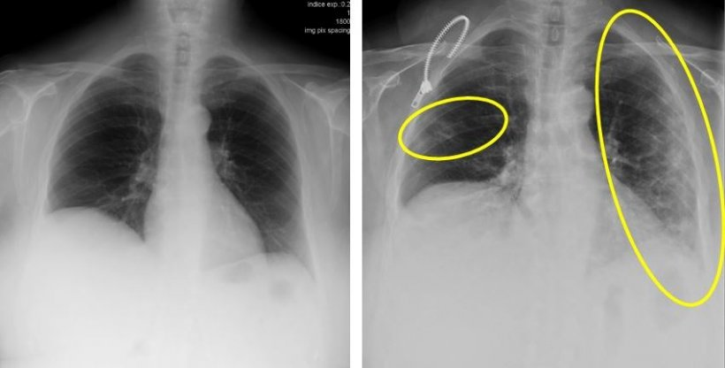
Abstract
How radiology help us detecting Covid_19 from Xrays?
Radiology is fundamental in this process. The radiologist's main contribution is to facilitate and expedite as much as possible the exploration, help design specific circuits and provide a fast and accurate report of the radiological findings that should indicate whether or not these are consistent with the COVID-19 coronavirus infection
Notes:
First, What is Parkinson Disease? PD is a motor system disorder resulting from the loss of the brain cells producing dopamine. It is a neurodegenerative disease.
On the right, the usual symptoms experienced by a PD person: The picture chooses a old man, because men over 60 are the most common person affected by the disease.

Slide 4
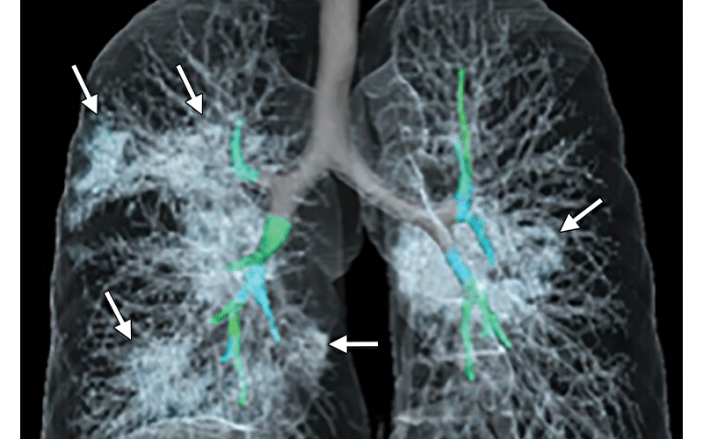
What are the typical radiological findings?
The findings that make us strongly suspect that we are dealing with a COVID-19 infection are the ground glass patterned areas, which, even in the initial stages, affect both lungs, in particular the lower lobes, and especially the posterior segments, with a fundamentally peripheral and subpleural distribution. These findings are present on chest CT in practically 50% of patients in the first two days; For this, in China, CT is being used as a screening or diagnostic method

Slide 5
Goals & Objectives
Detection of Covid-19 Disease using proper Biomarkers
Making a model with trained data to classify the the person if he is suffering from Covid-19 or not?
Make use of dataset that consist covid_19 Xray of Lungs and build a classification model that can be used in Android App

Slide 6
Proposed system
First we collect all the Data and then build a Using Azure Custom Vision
We Export the model using tensorflow.lite model and use it Android Phone and make a application for Covid Detection
The Application Will take the information of patient And Store it in Azure Sql database for analysis
The application will take image of Xray and tell us if it is Covid_19 or not using model build in Azure Custom Vision

Slide 7
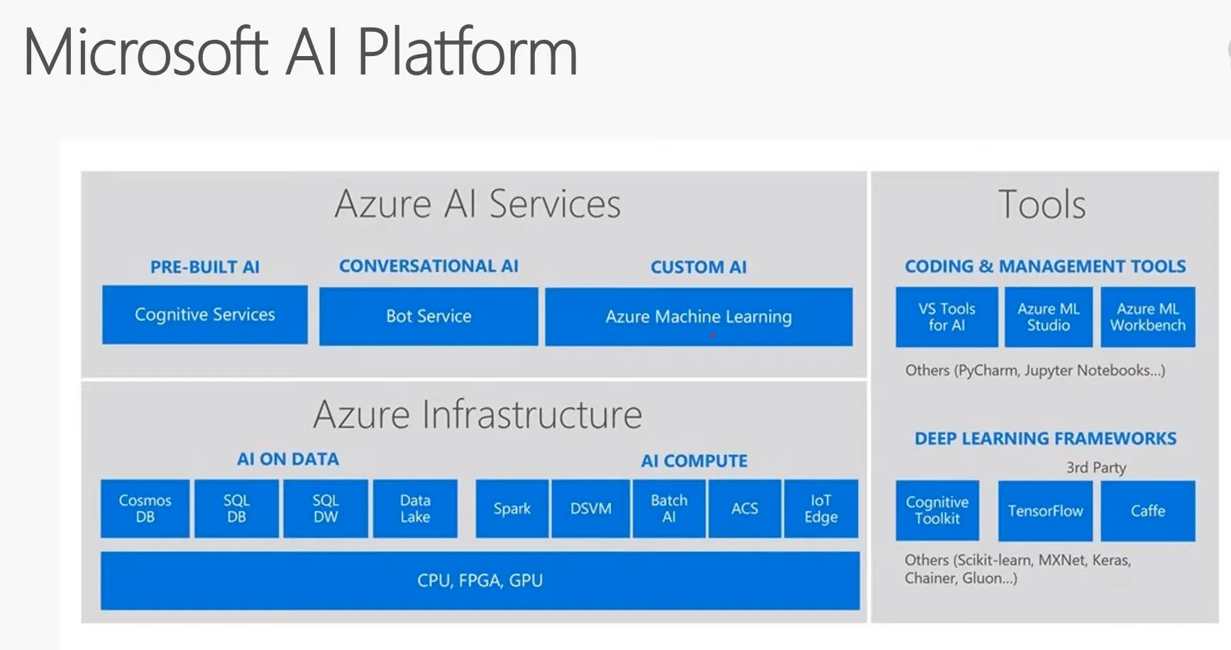

Slide 8
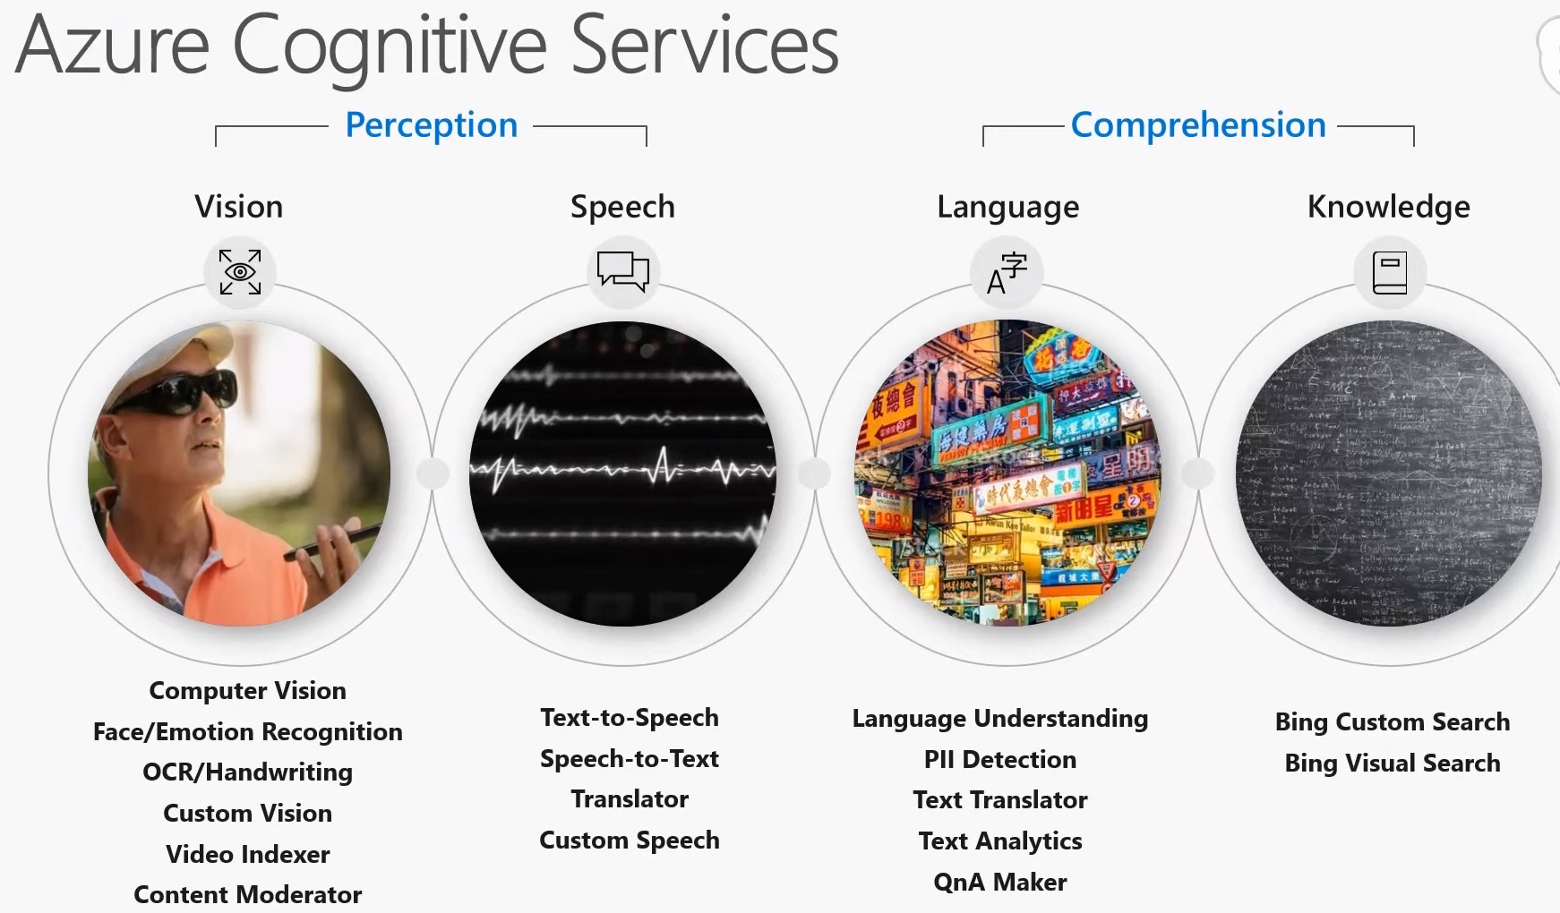

Slide 9
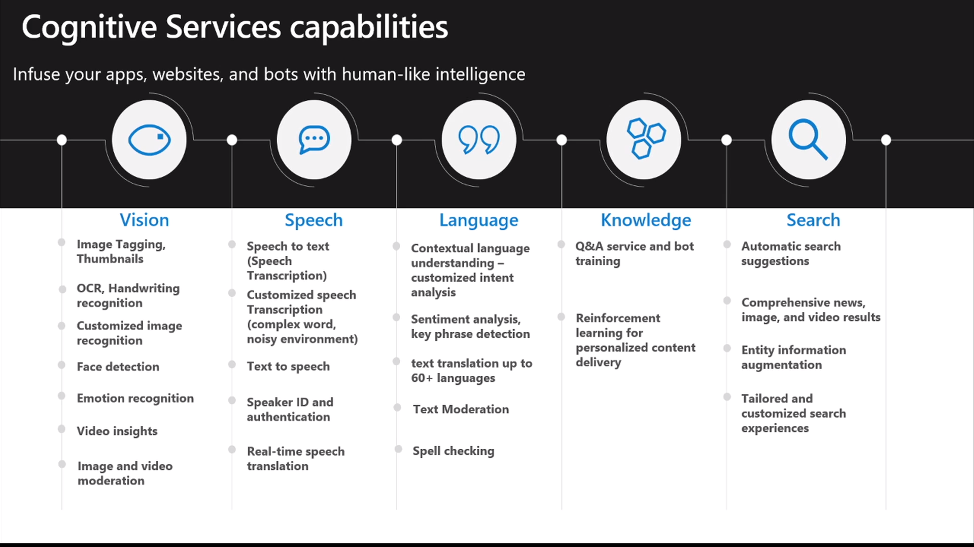

Slide 10
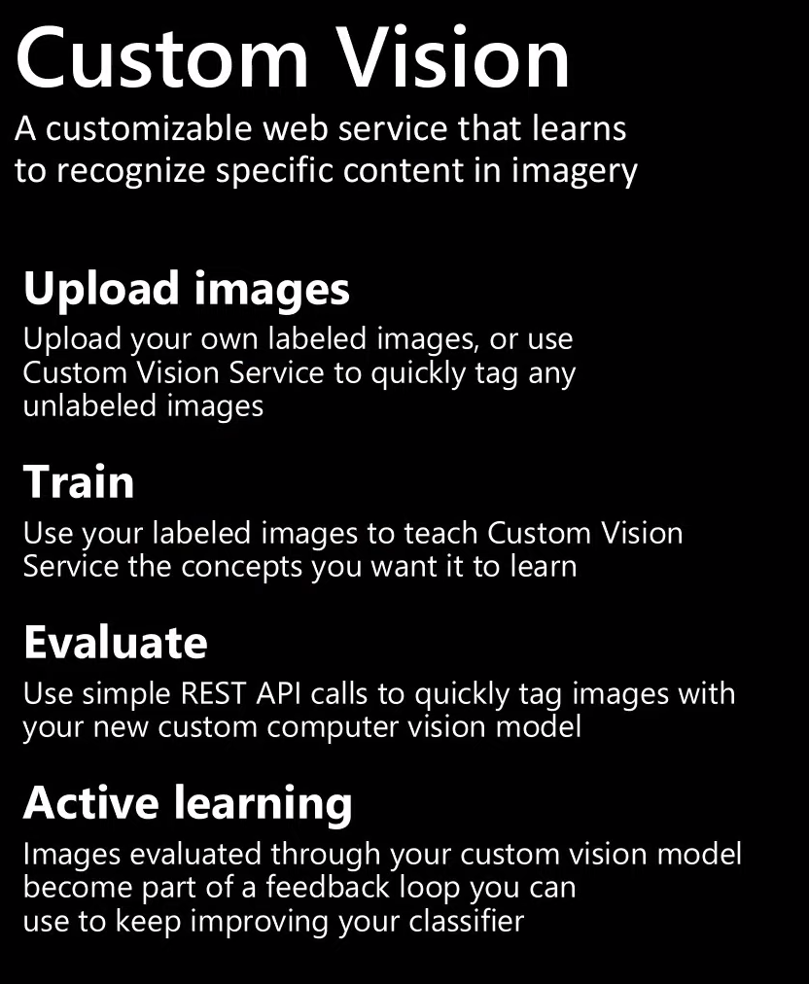
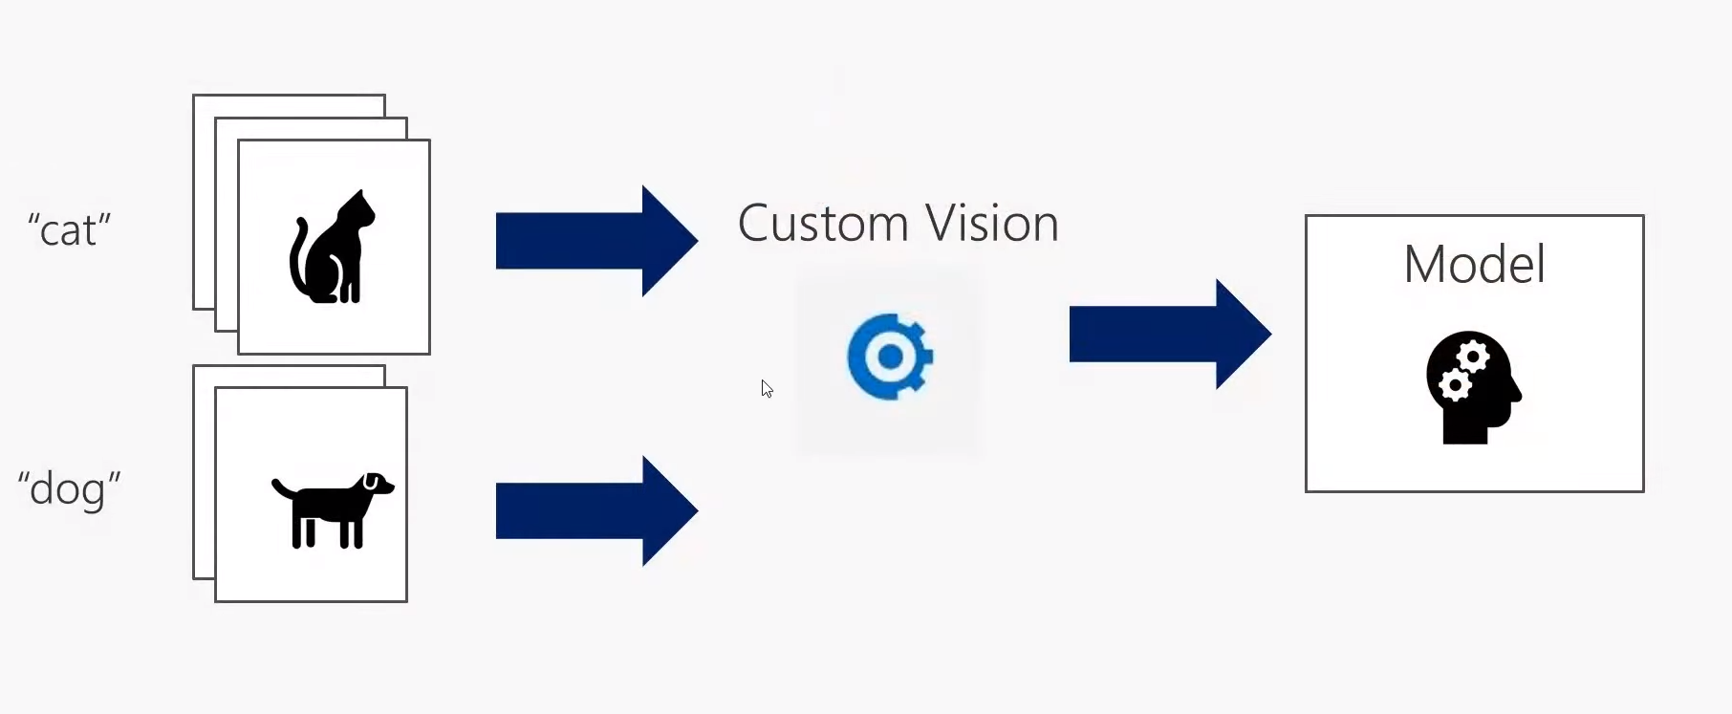
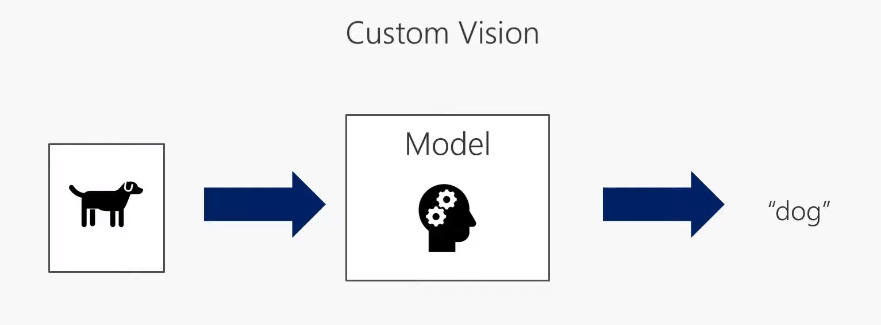

Slide 11
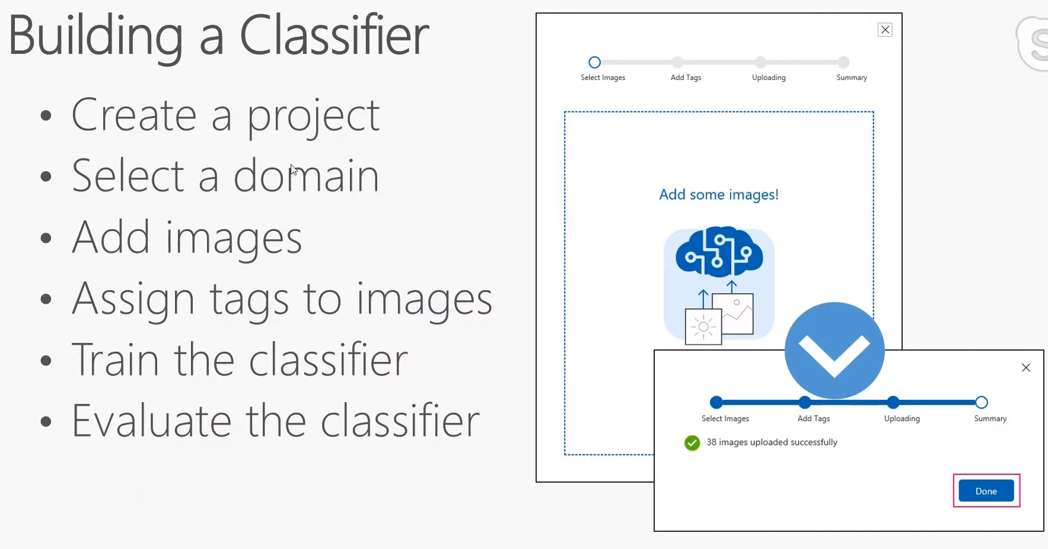

Slide 12
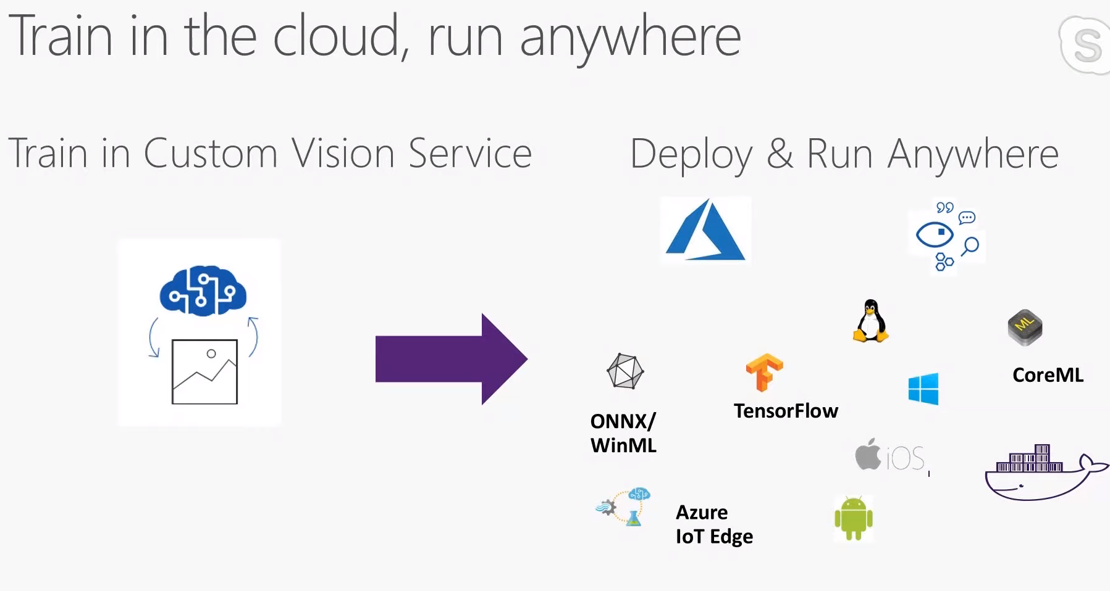

Slide 13
Why Choose Azure Custom Vision To Build Machine Learning?
Build Model without having any Knowledge of Machine Learning and Deep Learning And Integrate machine Learning in Your Application
Easy to use service with performance scores and saving Your training information
No Hardware like Gpu required As Azure custom Vision trains model on its infrastructure and cloud
The endpoint i.e the model can be used as an API saved on Azure Cloud on container or export models in tensorflow,tflite,CoreML...etc
The model can easily integrated in your Application and it will be hosted on Azure Cloud which will take care of scalability

Slide 14

Use Of Azure Sql Database
We have used Azure Sql database to store patient Information like Name,Age,Gender,Medical condition like heart disease and Diabetes
This Will Help us in Analysis and alert the patient if he has Covid and has any medical condition that can be fatal
Azure Sql is easy to integrate in Application using different connection strings,We have used JDBC

Slide 15
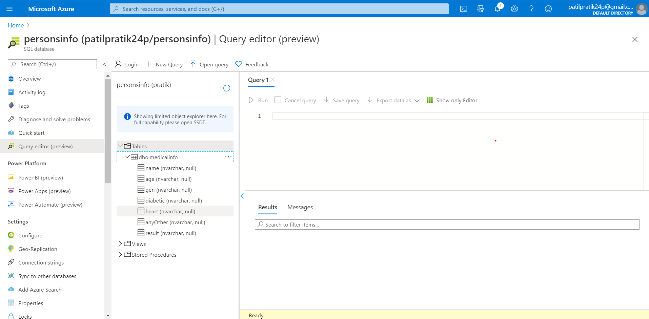
Azure SQL Database

Slide 16
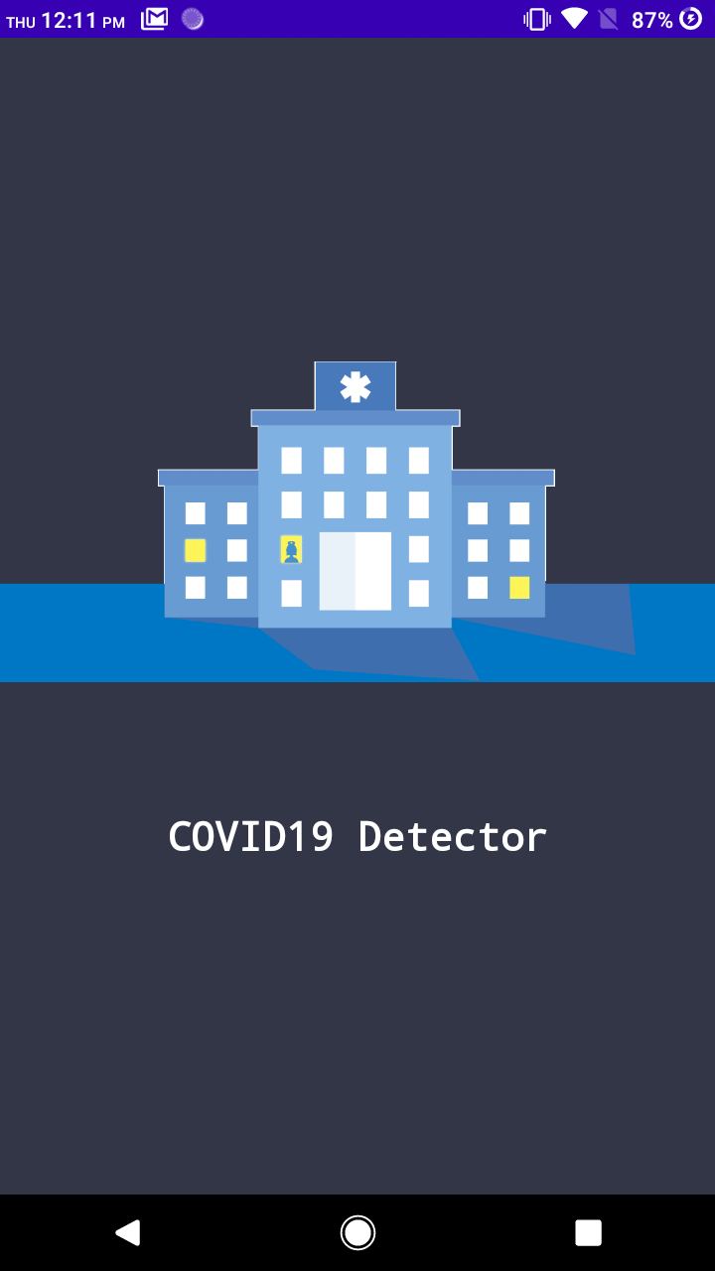
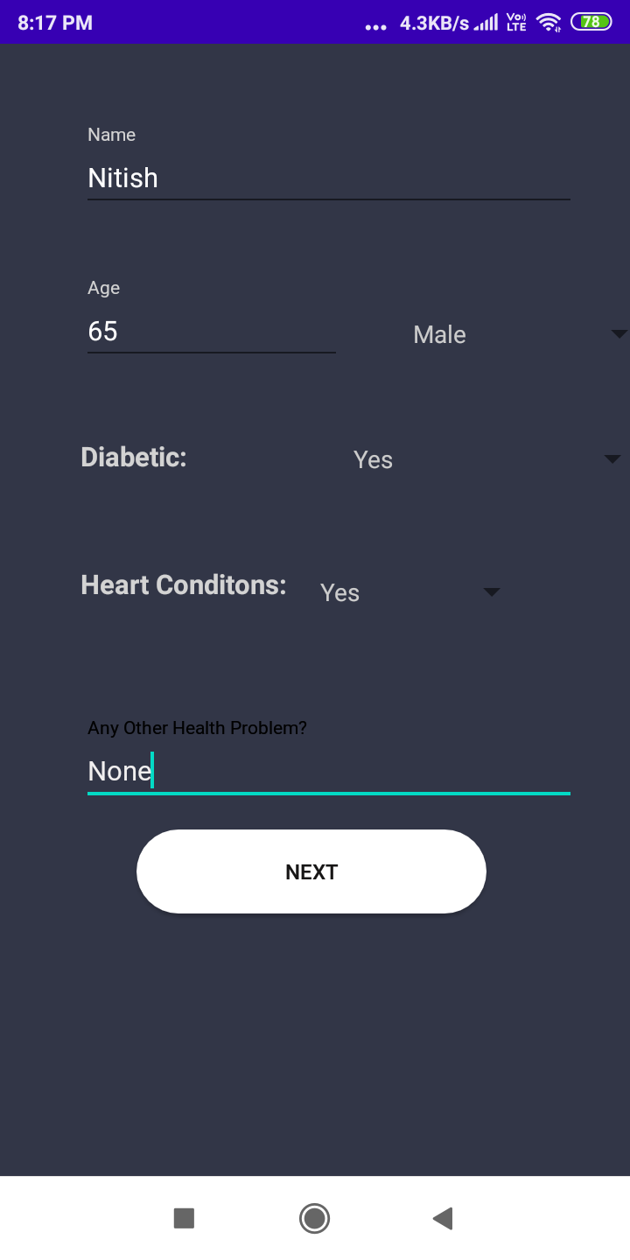
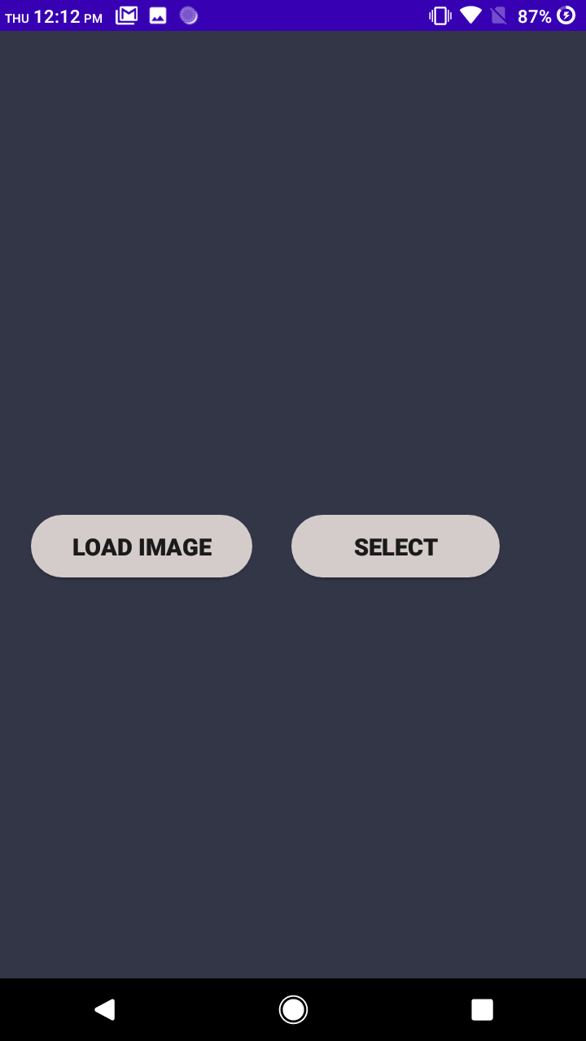
Introduction
Patient Info
Load Image and Select image from gallery

Slide 17
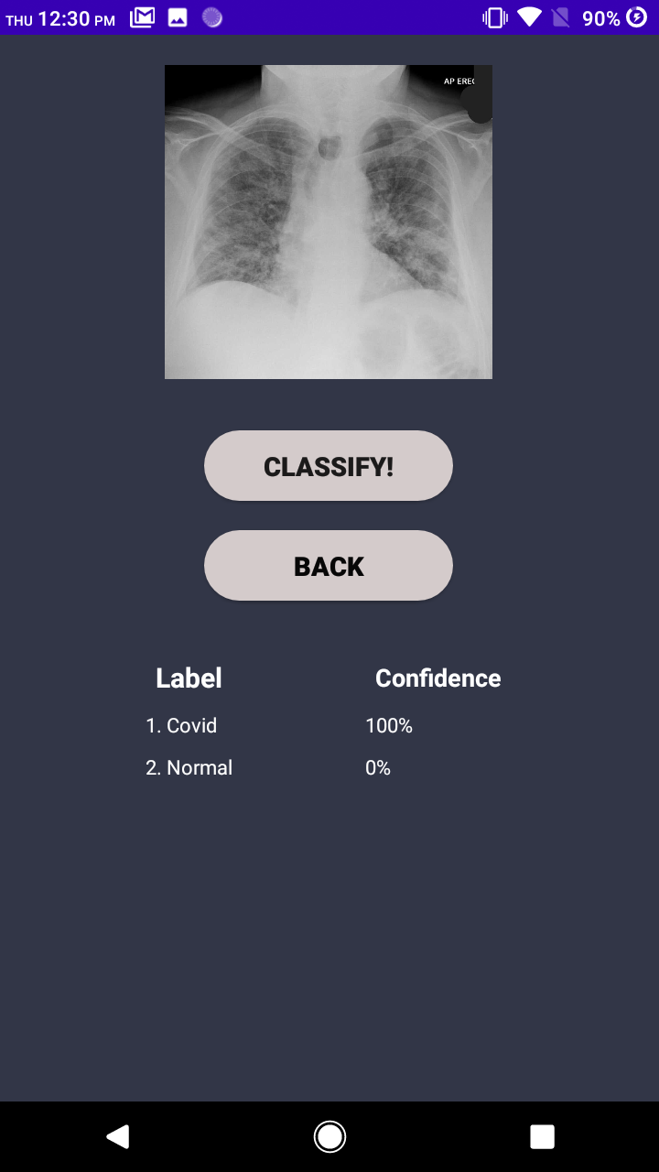
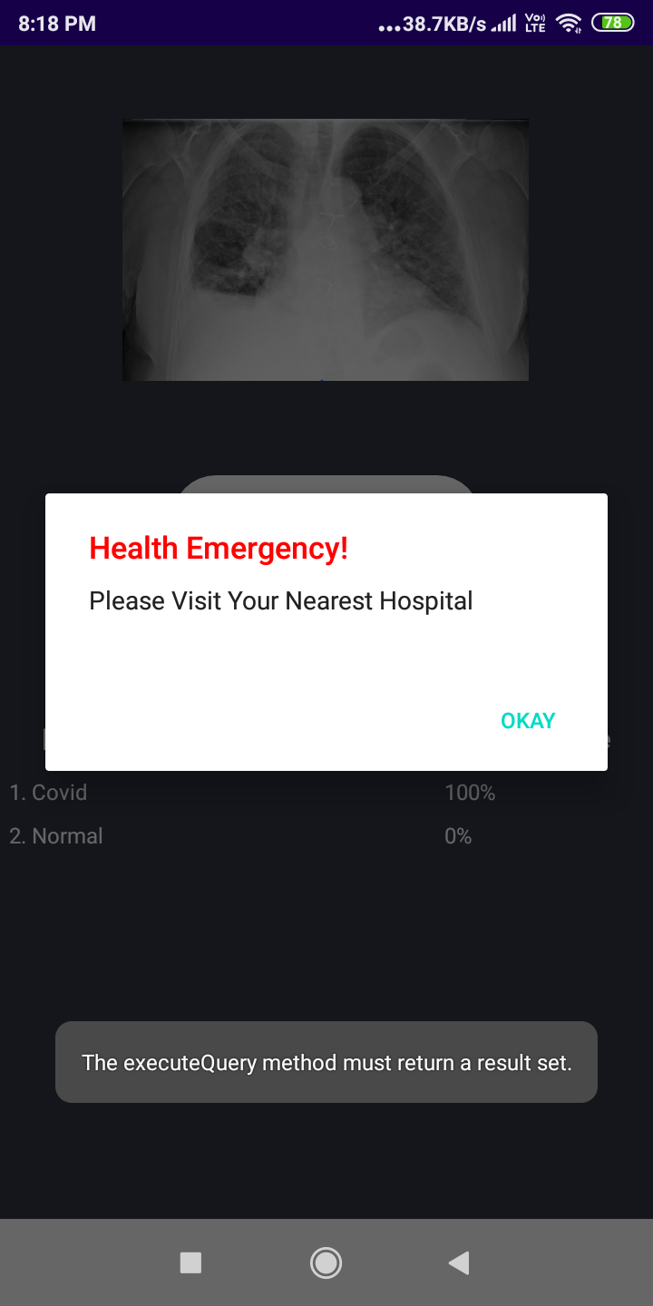
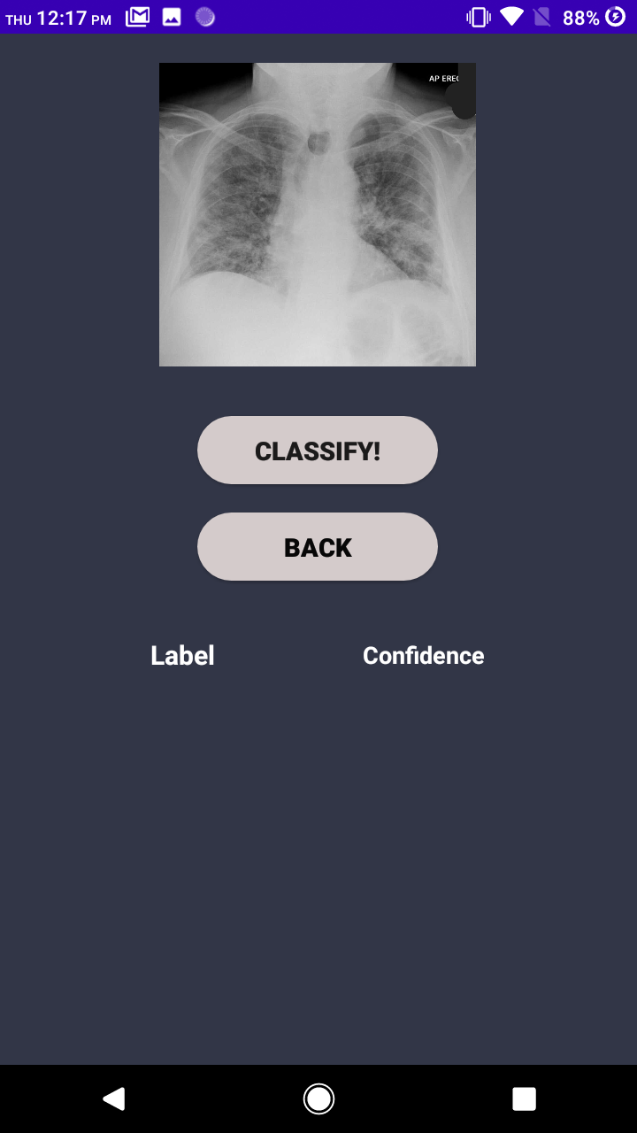
Click on Classify Button
Check The Result
Alert if Patient in Danger

Slide 18
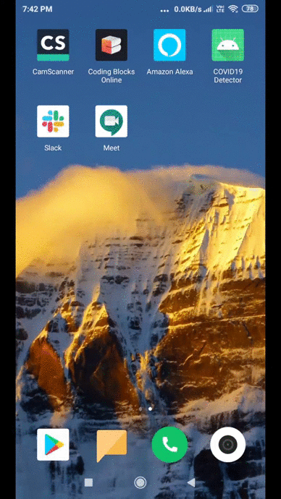
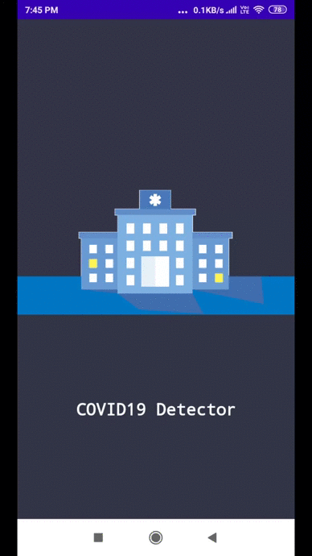
Prototype
Covid Prediction
Normal Prediction

Slide 19
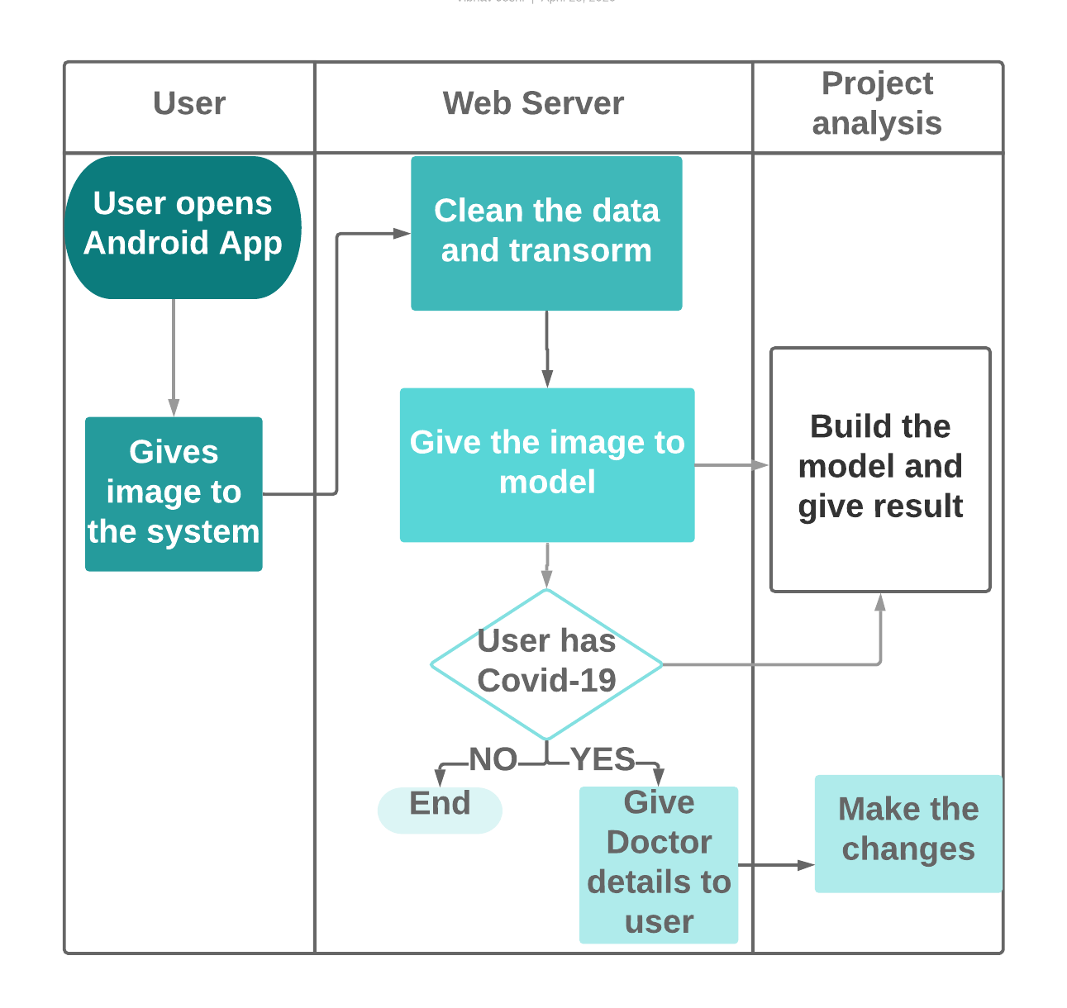
System Architecture

